Slide 1



Predictive Model Validation and Implementation Using Clinical Decision Support
Christopher Cruz, MSHI
Informatics Advisor, National Coordination Center
Lisiane Pruinelli, PhD, RN,
Assistant Professor, University of Minnesota School of Nursing

Slide 2
Session Objective:
z
Describe
Explain
the criteria of a successful predictive model
Review
the resampling methods, overlearning, K-fold cross-validation and boot strap
Demonstrate
the application of predictive model application using clinical decision support
Describe
the organizational implications for implementing predictive analytics.
the goals and purpose of predictive model validation

Slide 3
Goals for Validation of Predictive Model
z
To determine accuracy and generalizability of the model
To recognize and avoid overlearning
To quantify the performance of a model and how we can improve it performance

Slide 4
Cost of Unreliable Predictive Model
Patient Safety and Risk
Quality and Hospital-Acquired Conditions
Time Waste (development and application)
Financial
Notes:
University of Michigan PreDict
UCSF Cdiff

Slide 5
Problems to test
z
Overlearning
The number of possible combinations that may form a learning is exponential
Model parameters are too specific to training data
Insufficient learning data
Inadequate data set aside for testing and cross-validation
Application of improper model (e.g., linear model on variables with non-linear relationships).
Notes:
Architecting a learning process must strike a balance between learning too much and learning too little

Slide 6
Evaluating Performance
z
It’s impossible to design a learning method that’s guaranteed not to overlearn¹.
Hold aside some data to test the model (20-30%)
The remaining portion of data (training set) will be used to create the model.
Use lift to compare the performance of predictive models
Decision Tree Lift on the Training Set Lift on the Test Set
638 segments 3.8 2.4 (overlearning)
Notes:
¹Siegel, E (2016). Predictive Analytics: the power to predict who will click, buy, lie or die. Wiley

Slide 7
Evaluating Performance (Decision Tree)
Example of a Successful Model
Decision Tree Lift on the Training Set Lift on the Test Set
4 segments 2.5 2.5
10 segments 2.8 2.8
39 segments 3.0 3.0

Slide 8
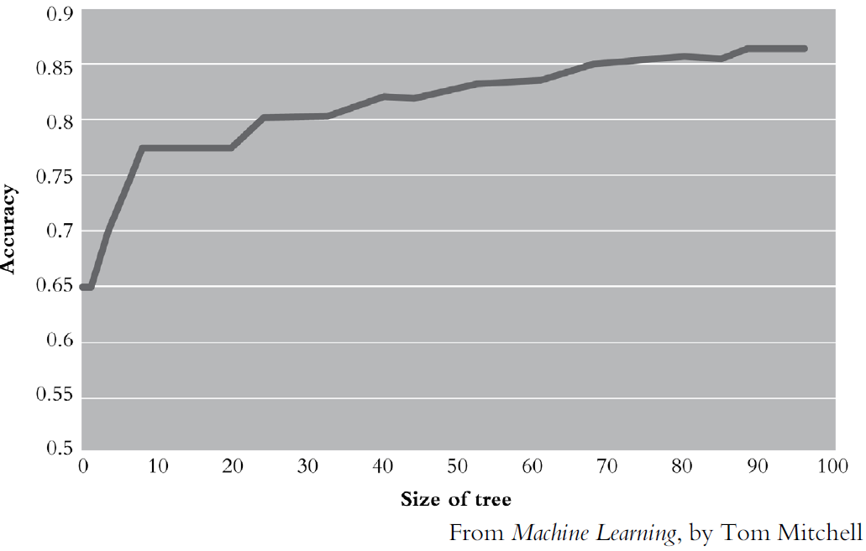
Successful Model (Decision Tree)

Slide 9
Evaluating Performance (Decision Tree)
Example of an Overlearning Model
Decision Tree Lift on the Training Set Lift on the Test Set
638 segments 3.9 2.4
Notes:
There is always a tension (tug-of-war) between learning and overlearning. The recommended approach is to overlearn and then cut-back on the tree.

Slide 10
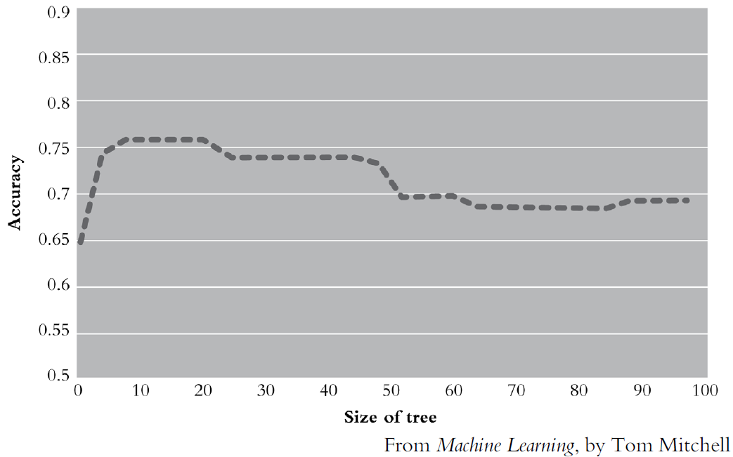
Overlearning Model (Decision Tree)

Slide 11
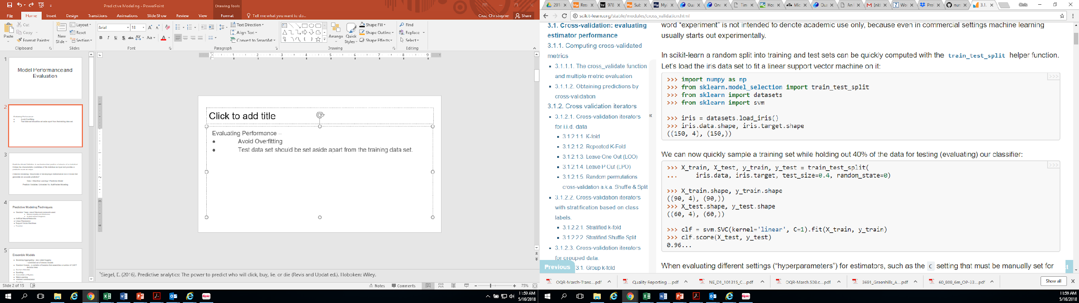
Evaluating Performance¹
Avoid Overfitting
Test data set should be set aside apart from the training data set.
Evaluation data set can also be used for final evaluation
Notes:
¹Scikit-learn: Machine Learning in Python, Pedregosa et al., JMLR 12, pp. 2825-2830, 2011.

Slide 12
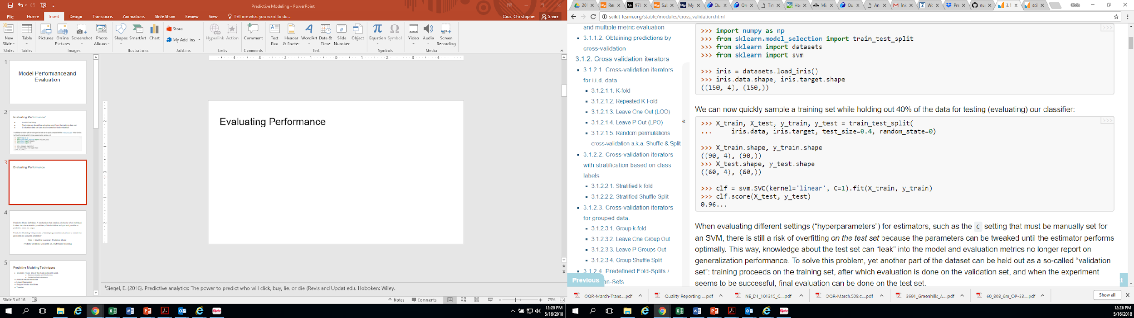
Evaluating Performance¹
This code (R) allocates 40% of the data for the testing/evaluation
Notes:
¹Scikit-learn: Machine Learning in Python, Pedregosa et al., JMLR 12, pp. 2825-2830, 2011.

Slide 13
Resampling Methods
Involve repeated drawing samples from a training set and refitting a model of interest on each sample in order to obtain additional information about the fitted model¹.
Two common resampling methods: Cross-validation and bootstrap
Provide estimates for test-set prediction error, standard deviation and bias of parameter estimates²
Notes:
¹James, G., Witten, D., & Hastie, T. (2013). An introduction to statistical learning with applications in R. New York: Springer New York. doi:10.1007/978-1-4614-7138-7
²Anonymous (n.d.) Cross-validation and bootstrap. Stanford Lagunita. Humanities Science. Statistical Learning.

Slide 14
Training and Test Errors¹
Test Error: the average error that results from using a statistical learning method to predict the response on a new observation.
Training Error: calculated by applying the statistical learning method to the observations used in the training.
Notes:
¹James, G., Witten, D., & Hastie, T. (2013). An introduction to statistical learning with applications in R. New York: Springer New York. doi:10.1007/978-1-4614-7138-7

Slide 15
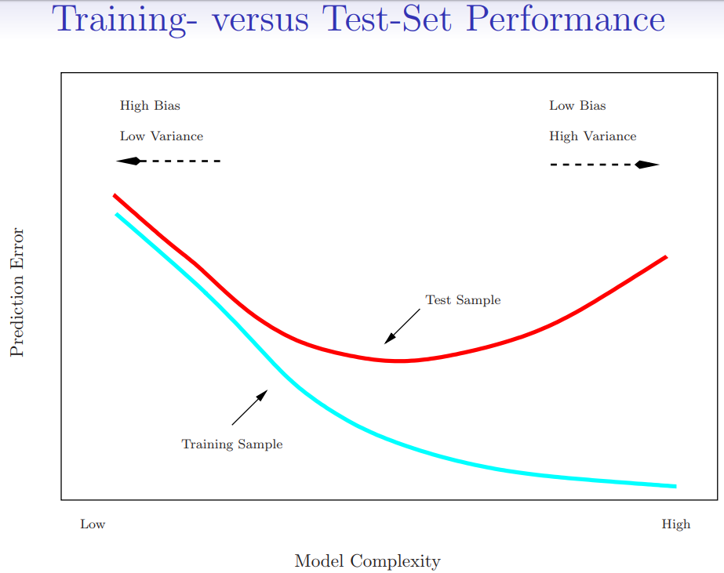
Training versus Test-Set Performance¹
Notes:
¹Anonymous (n.d.) Cross-validation and bootstrap. Stanford Lagunita. Humanities Science. Statistical Learning.
The validation estimate of the test error can be highly variable, depending on precisely which observations are included in the training set and which observations are included in the validation set.

Slide 16
Dataset Allocation
Training Dataset - used to build the model via a learning algorithm and to identify discriminating features of the predictor variables
Validation Dataset - used to assess how well the model perform against real data, to ensure stability and, in some cases, to fine-tune the model
Test Dataset - used to assess the prediction error of the final model
z
Notes:
¹Kuncheva L (2004). Combining pattern classifiers: methods and algorithms. John Wiley & Sons.
Split-Sample Validation
If both sub-sets of data (Training and Testing) provide about the same accuracy, then the model may be a good one –but it still needs further evaluation.
Use a hold-out sample (random records) to run against the model and see if the same accuracy scores are obtained.
Experimental validation using an external data set is the best method of validating a model and ensuring generalizability.
Partitioning may be used if one set of dataset is available. This may not be necessary if a separate validation (external dataset testing/validation) will be used.

Slide 17
Split-Sample Validation
Sample Dataset
Train (50%)
Validation (50%)
Model 1
Notes:
Source: Steyerberg, E. (2009). Clinical prediction models: A practical approach to development, validation, and updating. New York: Springer.
This is not ideal for data patterns of skewed distributions.
Drawback: Reduces dataset allocated for building the model. Less efficient method.
Simple but is not considered efficient form of validation.

Slide 18
Cross-Validation
Can be used to estimate the test error associated with a given statistical learning method in order to evaluate its performance, or to select the appropriate level of flexibility¹
Using new or separate data (apart from what’s used in the training data) to evaluate performance / predictive ability.
Split-Half Cross-validation - the model is developed on one randomly drawn half and tested on the other and vise versa¹.
The average is taken as estimate of performance²
Notes:
¹¹James, G., Witten, D., & Hastie, T. (2013). An introduction to statistical learning with applications in R. New York: Springer New York. doi:10.1007/978-1-4614-7138-7
²UCLA CTSI (n.d.). Bootstrap and Model Validation. University of California Los Angeles, Clinical and Translational Science Institute, Education and Training. Accelerating Discoveries Toward Better Health.
Cross-validation is an extension of split-sample validation, aiming for more stability

Slide 19
Cross-Validation
Sample 1
Train 1
(10%)
Train 2
(10%)
Train 3
(10%)
Train 4
(10%)
Train 5
(10%)
Train 6
(10%)
Train 7
(10%)
Train 8
(10%)
Train 9
(10%)
Validate
(10%)
Model 1
Model 2
Model 3
Model 4
Model 5
Model 6
Model 7
Model 8
Model 9
Notes:
Source: Steyerberg, E. (2009). Clinical prediction models: A practical approach to development, validation, and updating. New York: Springer.
Example here is a ten-fold cross-validation which data set uses 90% of the total sample for validation.
Performance measures is derived by averaging the tests of the n models
A problem is that cross-validation may not properly reflect all sources of model uncertainty, such as caused by automated variable selection methods.
Cross validation can suffer from bias or variance. Increasing the number of splits, the variance will increase too and the bias will decrease. On the other hand, if we decrease the number of splits, the bias will increase and the variance will decrease.

Slide 20
K-fold Cross-Validation¹
This approach involves the randomly dividing the set of observations into k groups, or folds of, approximately equal size.
The first fold is treated as a validation set, and the method is fit on the remaining k – 1 fold.
The procedure is repeated k times; each time, a different group of observations is treated as a validation set.
Notes:
¹James, G., Witten, D., & Hastie, T. (2013). An introduction to statistical learning with applications in R. New York: Springer New York. doi:10.1007/978-1-4614-7138-7

Slide 21
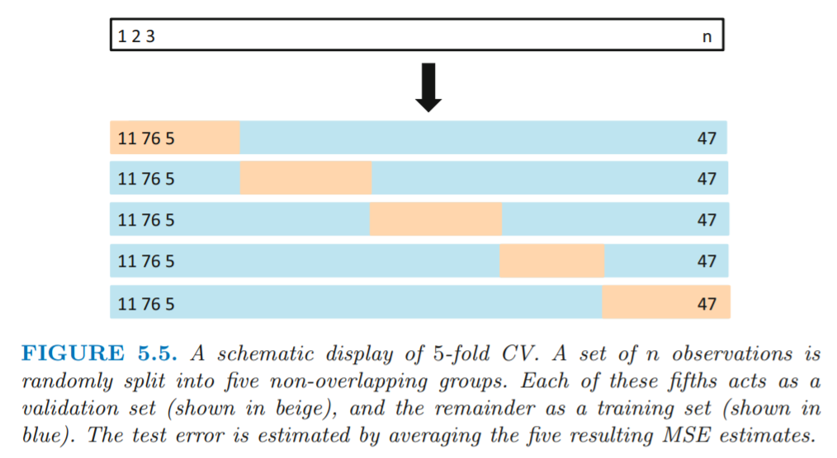
K-fold Cross-Validation¹
Notes:
¹James, G., Witten, D., & Hastie, T. (2013). An introduction to statistical learning with applications in R. New York: Springer New York. doi:10.1007/978-1-4614-7138-7

Slide 22
Bootstrap
A type of resampling technique used for validation of predictive model.
A bootstrap sample is taken from the original set used for testing.
The sample is returned to the original set and a new set of bootstrap sample is taken.
Validation measure is performed for each bootstrap sample.
The process is repeated numerous times (e.g., >100)
Overall test performance is derived from the average of all bootstrap test measurements.
Notes:
¹Anonymous (n.d.) Cross-validation and bootstrap. Stanford Lagunita. Humanities Science. Statistical Learning.
² UCLA CTSI (n.d.). Bootstrap and Model Validation. University of California Los Angeles, Clinical and Translational Science Institute, Education and Training. Accelerating Discoveries Toward Better Health.
Bootstrap theory says that the distance between the population mean and sample mean is similar to the distance between sample mean and bootstrap ‘subsample’ mean².
In the context of model validation, 100–200 bootstraps may often be sufficient to obtain stable estimates, but in one simulation study we reached a plateau only after 500 bootstrap repetitions. 401 With current computer power bootstrap validation is a feasible technique for most prediction problems.

Slide 23
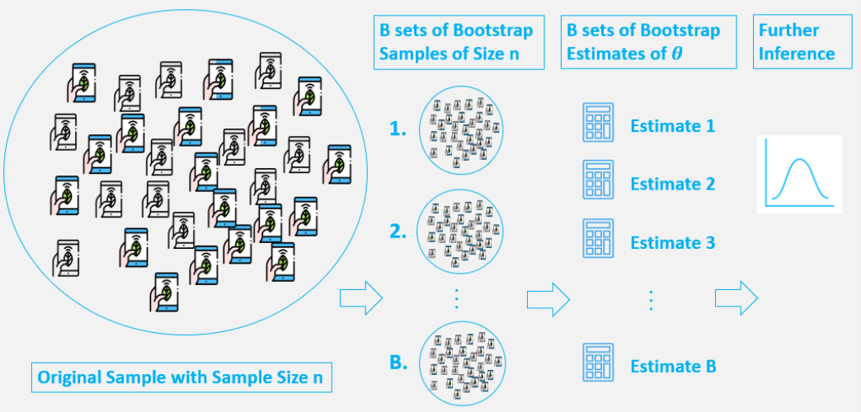
Bootstrap Example
Notes:
Source: Yun, L. (2019). An Introduction to the Boostrap Method. Towards Data Science. Retrieved on 6/2/2019 from https://towardsdatascience.com/an-introduction-to-the-bootstrap-method-58bcb51b4d60
Modern computing power and available resources/toolkit allows us this to be efficiently executed without manually repeating the # of numerous repititions.

Slide 24
General Validation Criteria
Reliability
Sensitivity
Specificity
Reproduceability (internal validity)
Generalizability
(external validity)
Notes:
Reproduceability (same population)
Generalizability - Transportability

Slide 25
Predictive Modeling and Validation Cycle
Build and Train Model
Validate (Historical data)
Re-Evaluate (Add more data)
Rebuild and Test
Validate
Testing
Notes:
Re-evaluation can use validation methods in traditional research
Make sure as you look at the outcome of your predictions that there are actual interventions that can take place based on the
results. To prove your model makes a difference with the intervention, you must have some way to compare it to existing
methods and demonstrate that your predictions actually improve health care (Miner et al., 2016).

Slide 26
Validation of Clinical Utility
The ability to deploy the model should be evaluated before the start of the project
Look at the outcome of your predictions to see if actual interventions that can take place based on the results.
Compare the model with existing methods to demonstrate that the predictions actually improve healthcare.
Notes:
Winters-Miner et al., 2015

Slide 27
Clinical Decision Support Systems (CDSS)
CDSS are integrated analysis and deployment systems designed to facilitate decision-making in patient care.
A process for enhancing health-related decisions and actions with pertinent, organized clinical knowledge, and patient information to improve health and healthcare delivery (HIMSS).
Notes:
Winters-Miner et al., 2015

Slide 28
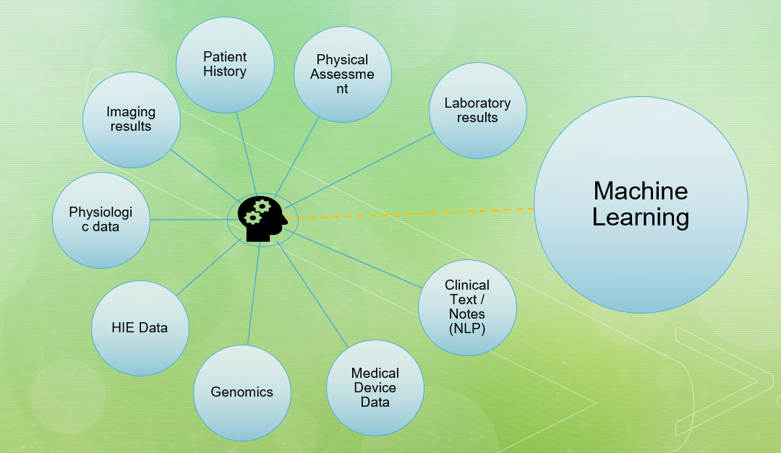
Clinical Decision Support Systems (CDSS)
Knowledge-base
Laboratory results
Physical Assessment
Imaging results
Physiologic data
Clinical Text / Notes (NLP)
Patient History
HIE Data
Medical Device Data
Genomics
Notes:
- CDSS can also be classified as Active and Passive
Winters-Miner et al., 2015
-There are so many variables in the medical decision-making process that outcomes based on knowledge versus those based on experience are often discordant.
-It is practicably impossible to teach physicians all of the knowledge acquired by experience, because the environmental variables are constantly changing so the body and nature of our experiences
evolve through time, reflecting particular outcomes under specific conditions.
- Non-knowledge based systems that do not use a set of defined a priori rules, but instead use artificial intelligence algorithms to induce the rules through machine learning methods, allowing the system to learn from hundreds or even thousands of encounters, rebuilding the “model” set of rules as environmental variables
change. These systems can be based on neural networks, genetic algorithms, support vector machines, decision trees, or any other machine learning technology, which “learns” to recognize patterns in data sets case by case.

Slide 29
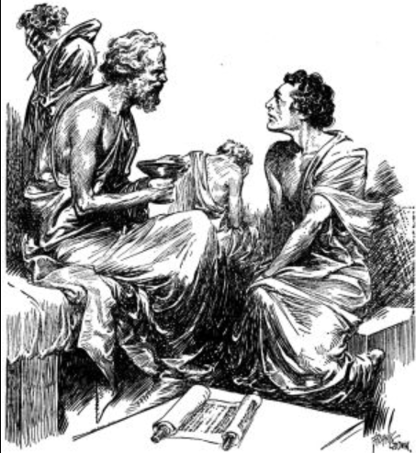
Platos’ Problem: Knowledge vs Experience Gap
Environmental variables are
constantly changing so the body and nature of our experiences evolve through time, reflecting particular outcomes under specific
conditions.
Notes:
Image source retrieved 6/1/2019 from http://www.skolavefurinn.is/_opid/islenska/bokmenntir/heimspeki/heimspekingar/sokrates/14_sokrates_2/sokrates_eiturdrykkur_4.jpg
Winters-Miner et al., 2015
- In such a hybrid system, multiple predicted outcomes are posed for the physician, based on data input from knowledge and experience bases, and furnished with associated probabilities to
permit the selection of the appropriate decision. As we continue to learn more about cognitive science, and distil this knowledge into principles, we can apply them to improve these “intelligent”
systems to help us make the best clinical decisions possible at the time. This practice of continuous incorporation of patient data, cognitive knowledge, and clinical experience is referred to often as
“rapid learning.” Rapid learning approaches that continuously update the CDSS as new data become available provide an ability to create decision models that adapt to the availability of new
treatments, interventions, and metrics (variables) that can be input to the modeling process.

Slide 30
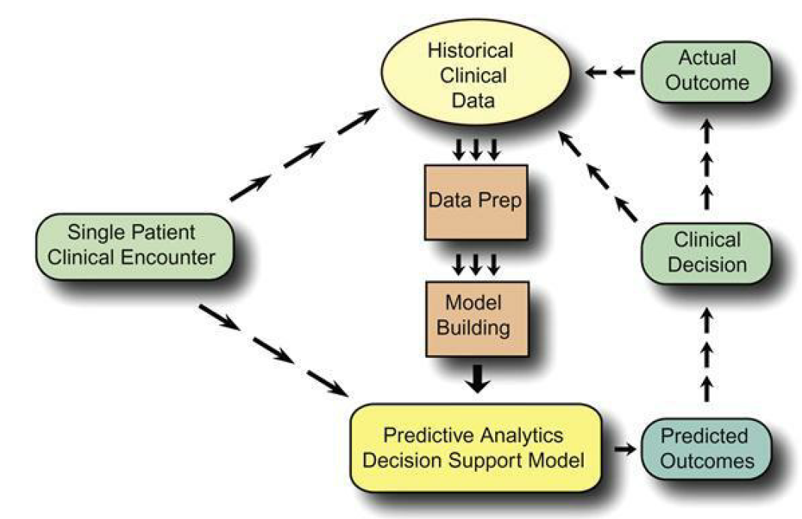
Hybrid CDSS
Developed to allow the end user to synthesize the results from both knowledge and clinical experience,
and make a clinical decision based on the results of both.
- (Walton, N., 2013)
Notes:
Winters-Miner et al., 2015
- In such a hybrid system, multiple predicted outcomes are posed for the physician, based on data input from knowledge and experience bases, and furnished with associated probabilities to
permit the selection of the appropriate decision. As we continue to learn more about cognitive science, and distil this knowledge into principles, we can apply them to improve these “intelligent”
systems to help us make the best clinical decisions possible at the time. This practice of continuous incorporation of patient data, cognitive knowledge, and clinical experience is referred to often as
“rapid learning.” Rapid learning approaches that continuously update the CDSS as new data become available provide an ability to create decision models that adapt to the availability of new
treatments, interventions, and metrics (variables) that can be input to the modeling process.

Slide 31
Implementation & Governance
Policies & Procedures
Scope of application of PA in clinical practice
Delineate expectation level to clinicians (i.e., prescriptive, augmentative, prognostic)
Model Management – activities for validating, documenting, and approving predictive models
Version Control
Real-Time Scoring – production environment
Leadership Reporting
Notes:
Winters-Miner et al., 2015
is typically guided by SOPs (standard operating procedures).
Depending on the specific application, the platform can be configured to enforce specific policies with respect to who can approve models (not the person[s] who built them), and how they must be documented to permit subsequent audits to replicate properly the process governing how specific models were built and how specific results were obtained.
Senstitivity, Specificity rates or AUC

Slide 32
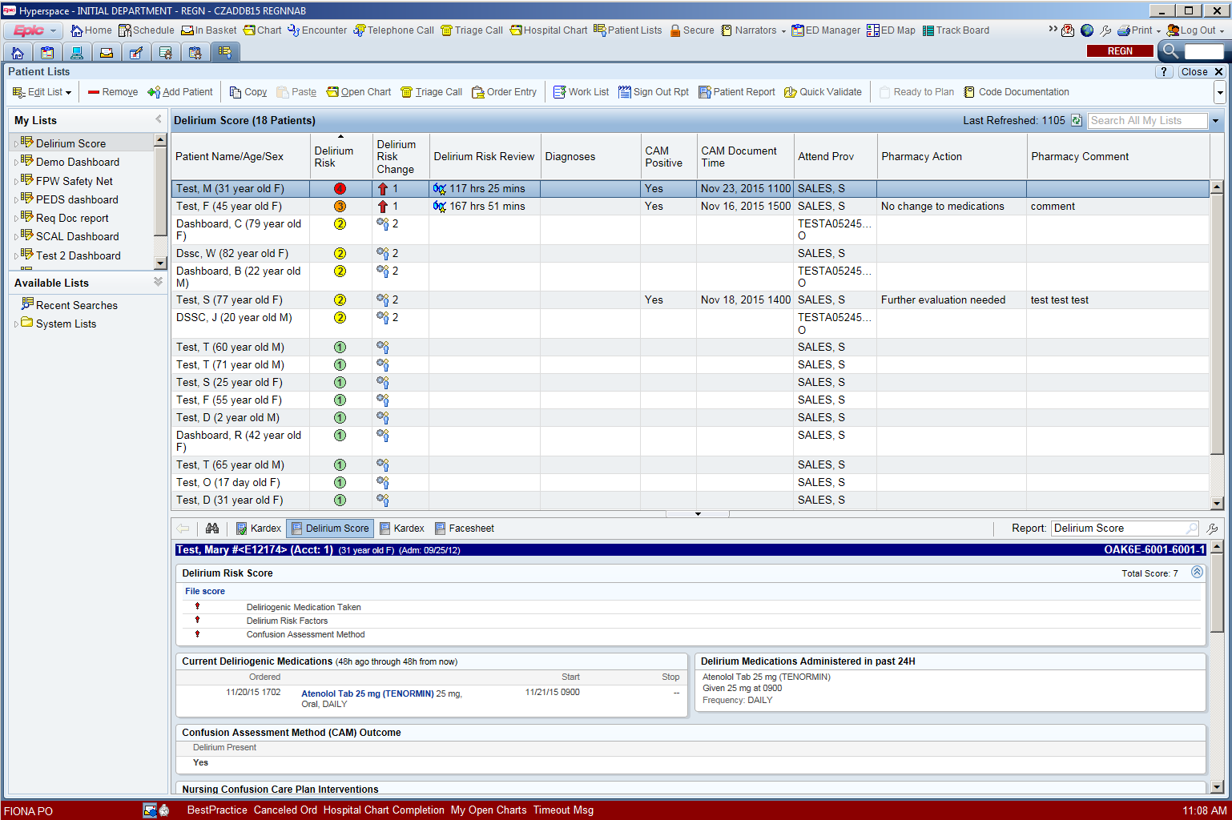
Delirium Shared System List in Epic: For Pharmacy, Nursing & Physicians
Notes:
A new systems list is available to review the current list of patients along with Delirium related information. This is located under the “Rx-Monitoring, Delirium” systems list folder. The columns on this system list can be added to any of your existing patient list or you can also create a new patient list and add these Delirium columns which can be used for your set of patients.
Patient list column information includes the Delirium Risk Level, the Risk Score Change, the Delirium Risk Pharmacy Review, the CAM Document Time, the Delirium Interventions, and Pharmacy Delirium Intervention Comments.

Slide 33
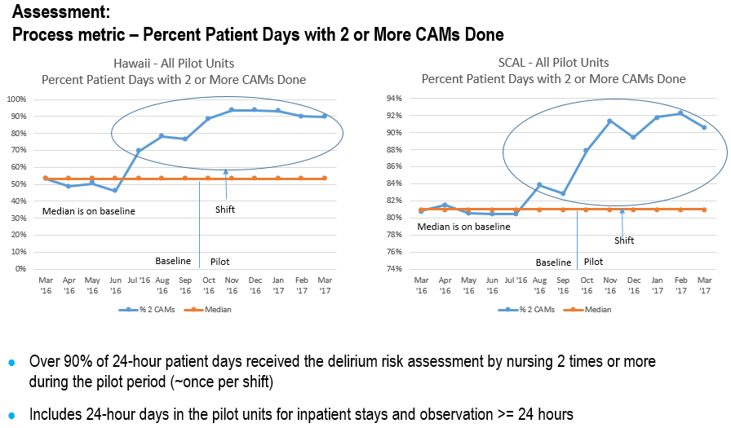
Pilot Evaluation Findings

Slide 34

Neuro-Radiology TBI
Topological data analysis – a machine learning technology which visualizes diverse datasets across multiple scales
- Is used to analyze array of data to predict brain tissue deterioration after traumatic brain injury
Notes:
Leigh, S., (2017). Artificial Intelligence Aids Scientists in Uncovering Hallmarks of Mystery Concussion. UCSF News. Retrieved on June 3, 2019 from https://www.ucsf.edu/news/2017/03/405926/artificial-intelligence-aids-scientists-uncovering-hallmarks-mystery-concussion

Slide 35
References:
Steyerberg, E. (2009). Clinical prediction models: A practical approach to development, validation, and updating. New York: Springer.
Winters-Miner, L.A., Bolding, P.S., Hilbe, J.M., Goldstein, M., Hill, T., Nisbet, R., Walton, N., & Miner, G.D., (2015) Practical Predictive Analytics and Decisioning Systems for Medicine: Informatics Accuracy and Cost-Effectiveness for Healthcare Administration and Delivery Including Medical Research, 1st Edition, Elsevier, London, UK.

